Slide 1
Web Technology Unit II- Client Side Technologies
By Pradnya Lodha

Slide 2
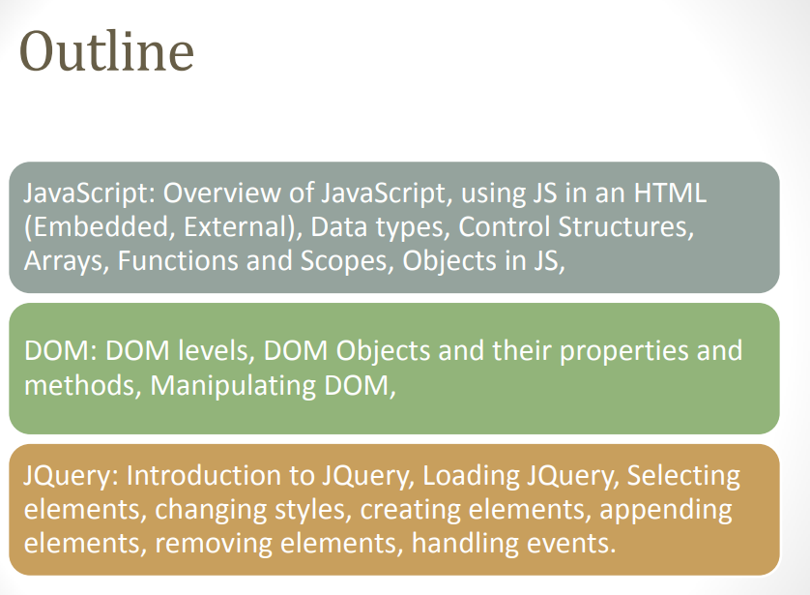

Slide 3
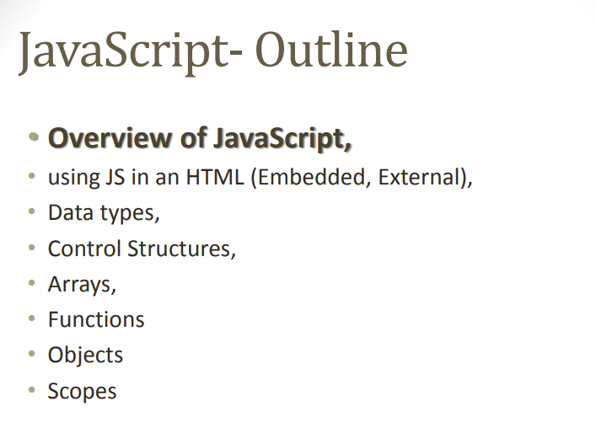
Notes:
3

Slide 4
Overview of JavaScript
JavaScript is one of the 3 languages all web developers must learn:
1 HTML to define the content of web pages
2 CSS to specify the layout of web pages
3 JavaScript to program the behavior of web pages
• JavaScript is a very powerful client-side scripting language.
• Javascript is a dynamic computer programming language

Slide 5
JavaScript
JavaScript is a front-end scripting language developed by Netscape for dynamic content
Lightweight, but with limited capabilities
Can be used as object-oriented language
Client-side technology
Embedded in your HTML page
Interpreted by the Web browser
Simple and flexible
Powerful to manipulate the DOM
Notes:
5

Slide 6
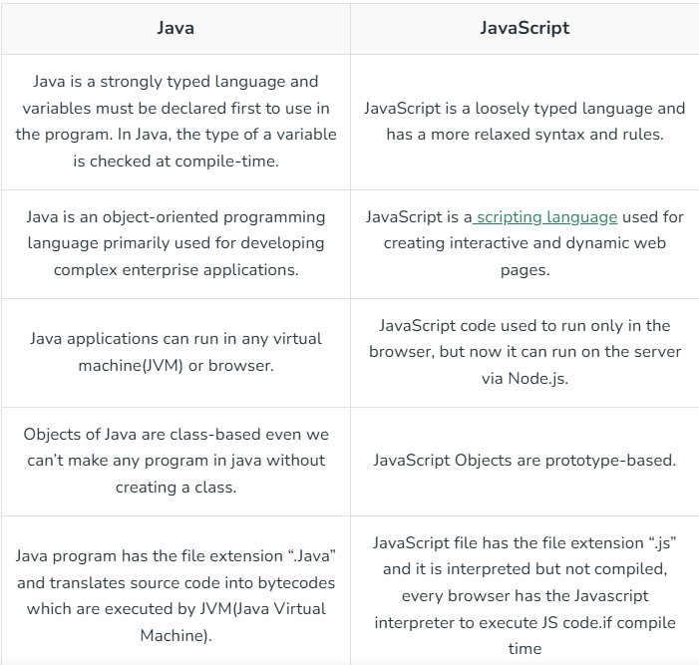
Difference between Java and Javascript

Slide 7
Javascript in perspective
1) Browser support – for running the javascript in the browser there is no need to use some plug-in. Almost all the popular browsers support JavaScripting.
Structure programming syntax – the java script supports much commonly the structured language type syntax ex – c style programming language
It automatically inserts the semicolon at the end of the statement, hence there is no need to write semicolon at the end of the statement.
Dynamic typing – it supports dynamic typing, that means the data type is bound to the value and not to the variable.
Run time evaluation – using the eval function the expression can be evaluated at run time
Support for object – it support object oriented scripting language.
Function programming – in javascript function are used. One function can accept another as a parameter

Slide 8
JavaScript can be implemented using HTML tags in a web page.
Place the <script> tag, within the <head> tag
Example:

Slide 9
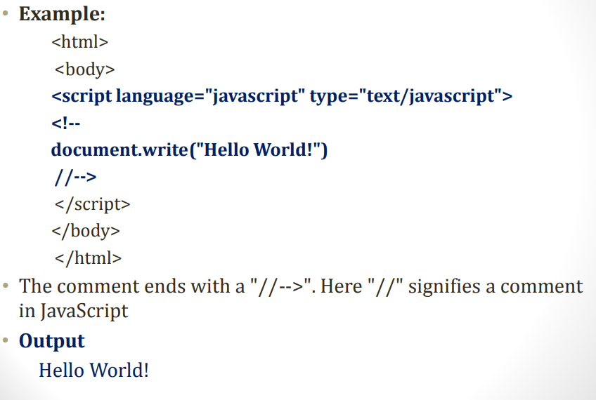

Slide 10
Indirectly embedding JavaScript
If script is written in some another file and we want to embed that script in the HTML document then we must write the script :
< script type = “text/javascript” src = “MyPage.js”>
------- </script>

Slide 11
Advantage and disadvantage of indirectly embedding of javascript
Script can be hidden from the browser user.
The layout and presentation of web document can be separated out from the user interaction through the javascript.
Disadvantage -
If small amount of javascript code has to be embeddeed in XHTML document then making a separate janaScript file is meaningless.
If the javascript code has to be embedded ar several places in XHTML document then it is complicated to make separate javaScript file and each time invoking the code for it from XHTML document..

Slide 12
Identifier,keywords and comments
Identifier must begin with either letter or underscore or dollar sign. It is then followed by any number of letter, underscore,dollar or digits
There is no limit on the length of identifiers.
The letters in the identifiers are case sensitive
Programmer defined variable names must no have upper case letters

Slide 13
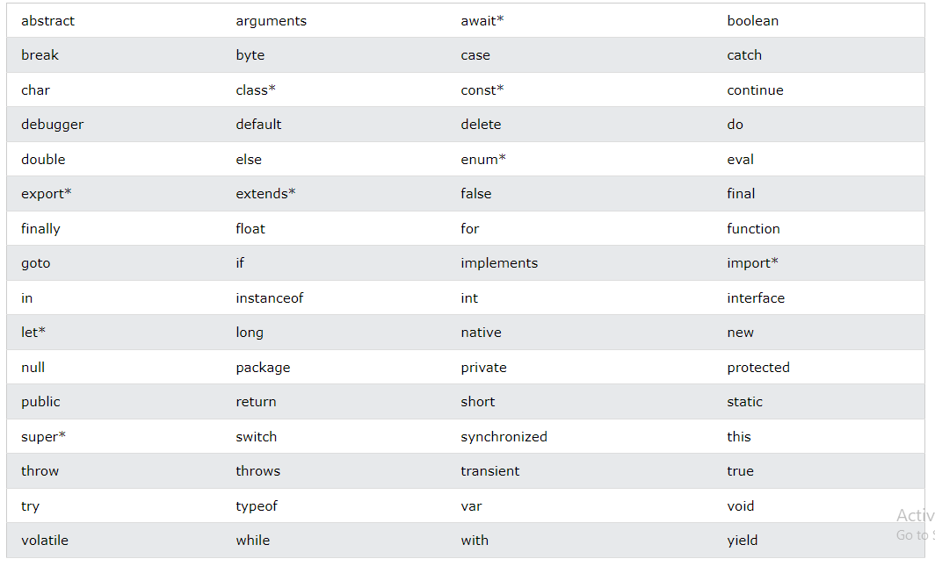
In JavaScript you cannot use these reserved words as variables, labels, or function names

Slide 14
comments
Single Line Comments - Any text between // and the end of the line will be ignored by JavaScript (will not be executed).
Multi-line Comments - Multi-line comments start with /* and end with */. Any text between /* and */ will be ignored by JavaScript.
While writing the javascript the web programmer must give semicolon at the end of statement

Slide 15
Data Types
Primitive types are the most basic data types in JavaScript. They are immutable, meaning their value cannot be changed once created.
1. String:
Represents textual data.
Example: "Hello, world!“
2. Number:
Represents both integer and floating-point numbers.
Example: 42, 3.14
3. BigInt:
Represents whole numbers larger than the Number type can hold.
Example: 1234567890123456789012345678901234567890n
4. Boolean:
Represents logical entities and can have two values: true or false.
Example: true, false

Slide 16
5. Undefined:
A variable that has been declared but has not been assigned a value.
Example: let x; // x is undefined
6. Null:
Represents the intentional absence of any object value.
Example: let x = null;
7. The Object Datatype – object is for an entity that represents some value. For Ex. – window object is a value using which the window is created. Form is an object upon which some compents such as butto,checkbox, radio buttons can be placed and used.

Slide 17
literal
There are two types of literal used in javascript and those are numeric literals and string literal.
The numeric literals are called numbers.
These number can include integer vaues,floating point or double precision values.
The string literals are the sequence of characters. It can be written in double quotes or in single quotes.

Slide 18
variables
Variables are Containers for Storing Data JavaScript Variables can be declared in 4 ways:
1. Automatically
2. Using var
3. Using let
4. Using const
Note
The var keyword was used in all JavaScript code from 1995 to 2015.
The let and const keywords were added to JavaScript in 2015.
The var keyword should only be used in code written for older browsers.

Slide 19
<!DOCTYPE html>
<html>
<body>
<h1>JavaScript Variables</h1>
<p>In this example, x, y, and z are variables.</p>
<p id="demo"></p>
<script>
const x = 5;
const y = 6;
const z = x + y;
document.getElementById("demo").innerHTML =
"The value of z is: " + z;
</script>
</body>
</html>
Output –
JavaScript Variables
In this example, x, y, and z are variables.
The value of z is: 11

Slide 20
When to Use var, let, or const?
When to Use var, let, or const?
1. Always declare variables
2. Always use const if the value should not be changed
3. Always use const if the type should not be changed (Arrays and Objects)
4. Only use let if you can't use const
5. Only use var if you MUST support old browsers.

Slide 21
JavaScript Operators
Examples:
The Assignment Operator = assigns values
The Addition Operator + adds values
The Multiplication Operator * multiplies values
The Comparison Operator > compares values

Slide 22
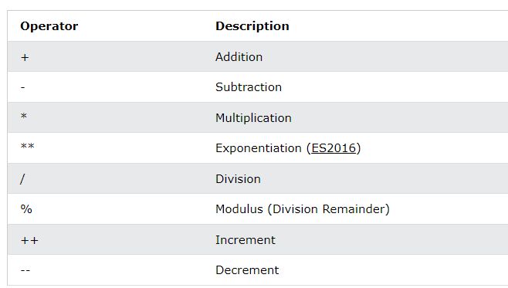

Slide 23
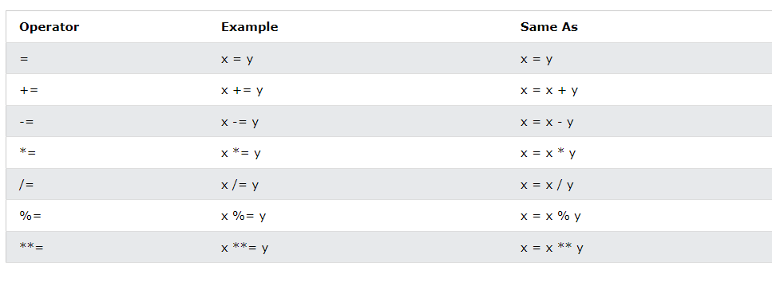
JavaScript Assignment Operators

Slide 24
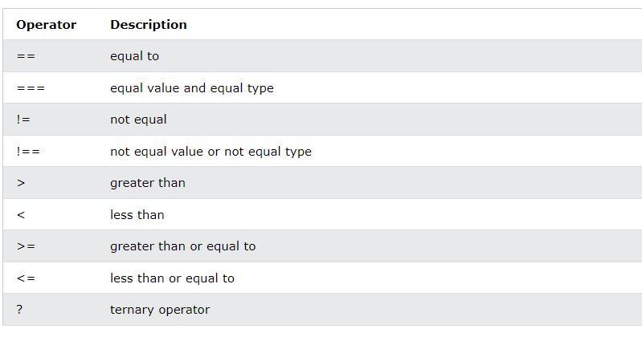
JavaScript Comparison Operators

Slide 25
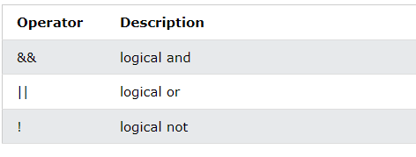
JavaScript Logical Operators

Slide 26
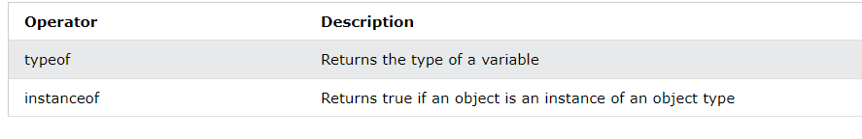
JavaScript Type Operators

Slide 27
https://www.w3schools.com/js/js_operators.asp

Slide 28
Input and output
For displaying the message on the web browser the basic method being used is docuent.write(). To print desired message on web browser. We write message in double quotes inside the document.write method
document.write(“Great India”)
We can pass the variable instead of a stringas a paramenter to the document.write
Ex- var my_msg – “great India”;
document.write(my_msg);

Slide 29
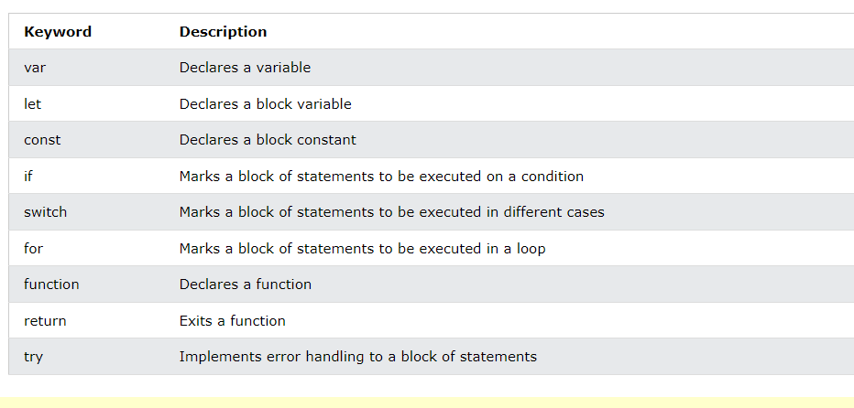
statement

Slide 30
JavaScript if, else, and else if Conditional Statements
Use if to specify a block of code to be executed, if a specified condition is true
Use else to specify a block of code to be executed, if the same condition is false
Use else if to specify a new condition to test, if the first condition is false
Use switch to specify many alternative blocks of code to be executed

Slide 31
The else if Statement
if (condition1) { // block of code to be executed if condition1 is true } else if (condition2) { // block of code to be executed if the condition1 is false and condition2 is true } else { // block of code to be executed if the condition1 is false and condition2 is false }
Try - https://www.w3schools.com/js/js_if_else.asp

Slide 32
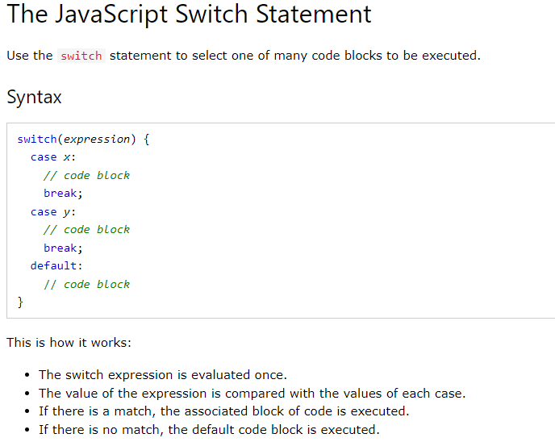
switch

Slide 33
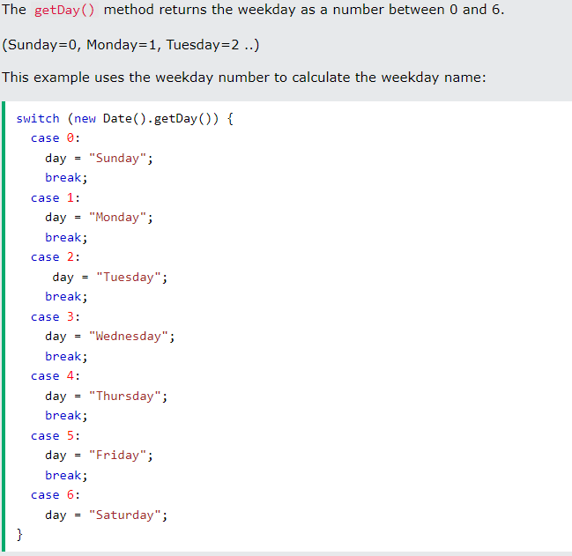

Slide 34
The break Keyword
When JavaScript reaches a break keyword, it breaks out of the switch block.
This will stop the execution inside the switch block.
The default Keyword - The default keyword specifies the code to run if there is no case match:
Try - https://www.w3schools.com/js/js_switch.asp

Slide 35
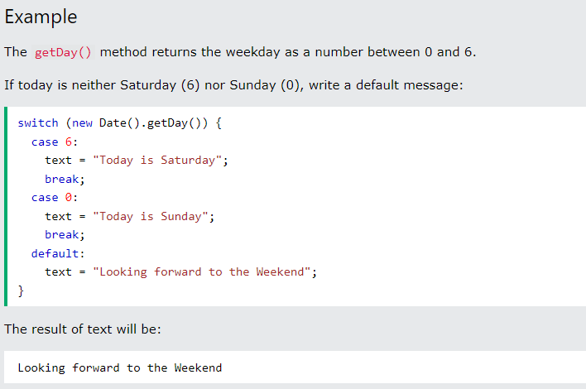

Slide 36
Loop statement
The for statement creates a loop with 3 optional expressions:
for (expression 1; expression 2; expression 3) { // code block to be executed }
Expression 1 is executed (one time) before the execution of the code block.
Expression 2 defines the condition for executing the code block.
Expression 3 is executed (every time) after the code block has been executed.
for (let i = 0; i < 5; i++) { documrnt.write(+i) }

Slide 37
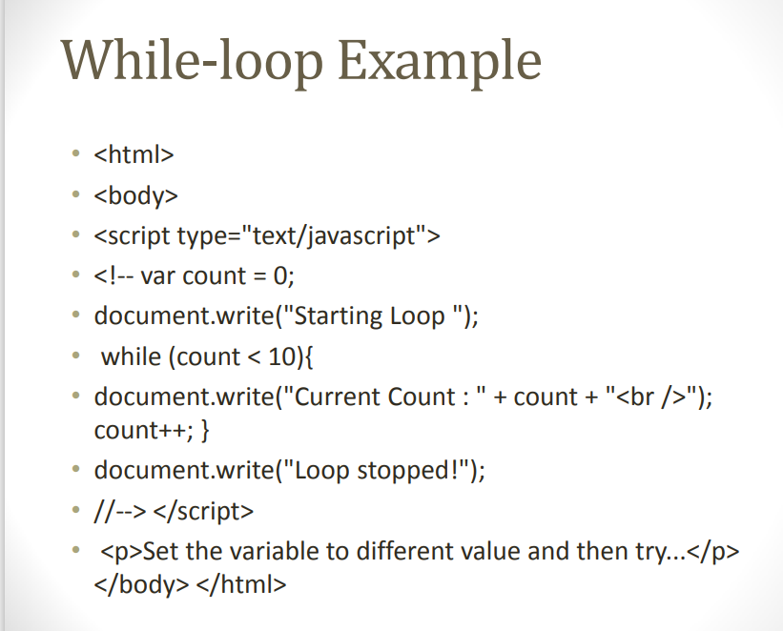

Slide 38
JavaScript Break and Continue
The break statement "jumps out" of a loop.
The continue statement "jumps over" one iteration in the loop.
Try - https://www.w3schools.com/js/js_break.asp

Slide 39
function
With functions you can reuse code
You can write code that can be used many times.
You can use the same code with different arguments, to produce different results.
<!DOCTYPE html>
<html>
<body>
<h1>JavaScript Functions</h1>
<p>Call a function which performs a calculation and returns the result:</p>
<p id="demo"></p>
<script>
function myFunction(p1, p2) {
return p1 * p2;
}
let result = myFunction(4, 3);
document.getElementById("demo").innerHTML = result;
</script>
</body>
</html>
o/p
JavaScript Functions
Call a function which performs a calculation and returns the result:
12

Slide 40
JavaScript Function Syntax
function name(parameter1, parameter2, parameter3) { // code to be executed }
Function parameters are listed inside the parentheses () in the function definition.
Function arguments are the values received by the function when it is invoked.
Inside the function, the arguments (the parameters) behave as local variables.

Slide 41
Function Return
// Function is called, the return value will end up in x let x = myFunction(4, 3); function myFunction(a, b) { // Function returns the product of a and b return a * b; }
hen JavaScript reaches a return statement, the function will stop executing.
If the function was invoked from a statement, JavaScript will "return" to execute the code after the invoking statement.
Functions often compute a return value. The return value is "returned" back to the "caller":

Slide 42
Built in object
Math.pow() - Math.pow(x, y) returns the value of x to the power of y:
Math.pow(8, 2);
Ex - https://www.w3schools.com/js/tryit.asp?filename=tryjs_math_pow
Math.sqrt() - Math.sqrt(x) returns the square root of x:
Example - Math.sqrt(64);
https://www.w3schools.com/js/js_math.asp

Slide 43
Properties Of JavaScript Number:
Number.MAX_VALUE: largest possible number get displayed.
Number.MIN_VALUE: smallest possible number gets displayed. Number.NAN:when not a number then NAN is displayed
Number.NEGATIVE_INFINITY: It’s a particular value that represents negative infinity. it has a lower value than MIN_VALUE.
Number.POSITIVE_INFINITY: It’s a particular value that represents positive infinity. it has a greater value than MAX_VALUE.
Try - https://www.w3schools.com/js/js_number_properties.asp

Slide 44
Number.MAX_VALUE
!DOCTYPE html>
<html>
<body>
<h1>JavaScript Numbers</h1>
<h2>The MAX_VALUE Property</h2>
<p>The largest possible number in JavaScript is:</p>
<p id="demo"></p>
<script>
let x = Number.MAX_VALUE;
document.getElementById("demo").innerHTML = x;
</script>
</body>
</html>
Output - JavaScript Numbers
The MAX_VALUE Property
The largest possible number in JavaScript is:
1.79769313486231578

Slide 45
JavaScript POSITIVE_INFINITY
<!DOCTYPE html>
<html>
<body>
<h1>JavaScript Numbers</h1>
<h2>The POSITIVE_INFINITY Property</h2>
<p>POSITIVE_INFINITY is returned on overflow:</p>
<p id="demo"></p>
<script>
let x = 1 / 0;
document.getElementById("demo").innerHTML = x;
</script>
</body>
</html>
Output ; avaScript Numbers
The POSITIVE_INFINITY Property
POSITIVE_INFINITY is returned on overflow:
Infinity

Slide 46
JavaScript NEGATIVE_INFINITY
<!DOCTYPE html>
<html>
<body>
<h1>JavaScript Numbers</h1>
<h2>The NEGATIVE_INFINITY Property</h2>
<p>NEGATIVE_INFINITY is returned on overflow:</p>
<p id="demo"></p>
<script>
let x = -1 / 0;
document.getElementById("demo").innerHTML = x;
</script>
</body>
</html>
Output - JavaScript Numbers
The NEGATIVE_INFINITY Property
NEGATIVE_INFINITY is returned on overflow:
-Infinity

Slide 47
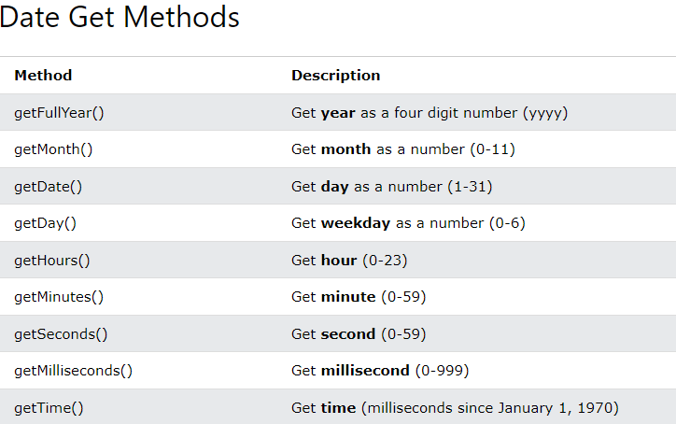
Date Get Methods – try - https://www.w3schools.com/js/js_date_methods.asp

Slide 48
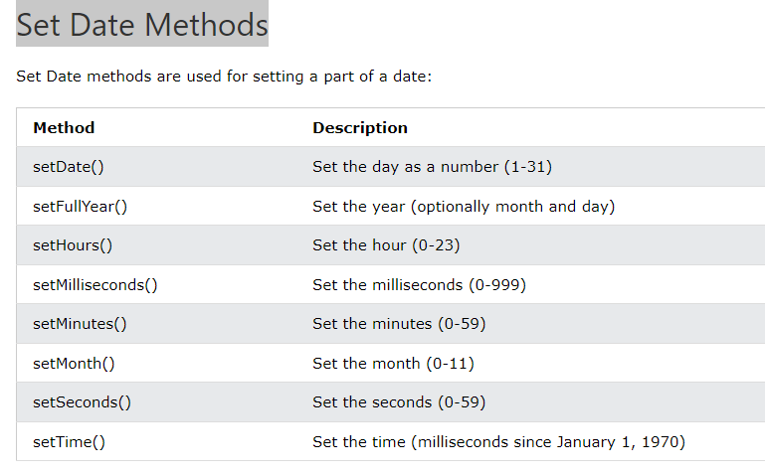
Set Date Methods try - https://www.w3schools.com/js/js_date_methods_set.asp

Slide 49
Boolean object
https://www.w3schools.com/js/js_booleans.asp

Slide 50
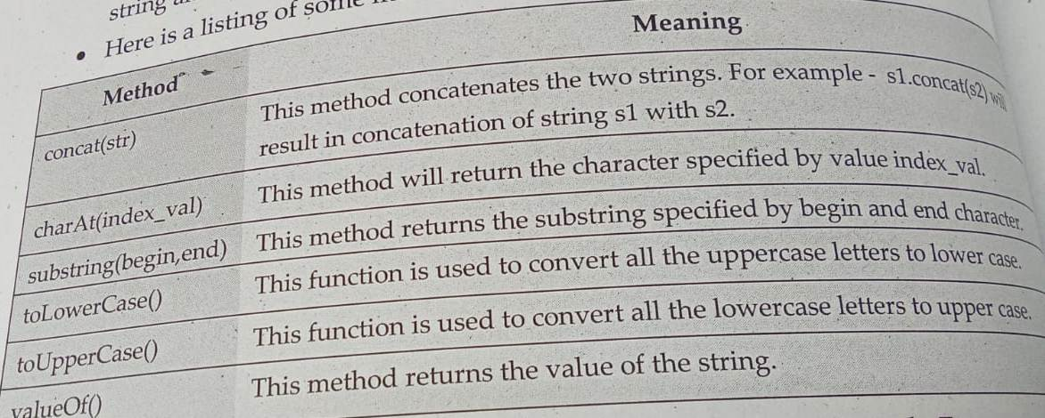
String object

Slide 51
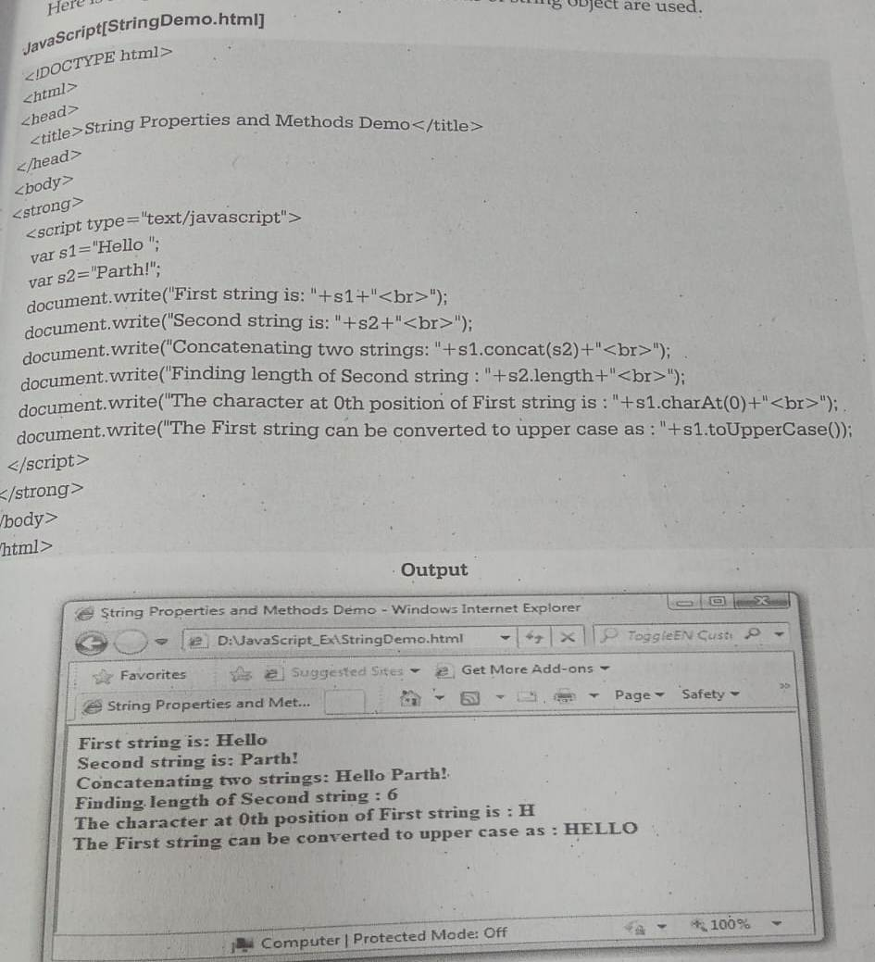

Slide 52
Creation of object
The web designer can create an object and set its properties as per his requirements
The object can be created using new expression.
Initially the object with no properties can be set using following statements
Myobj = new Object ();
Using dot operator we can set the properties for that object.

Slide 53
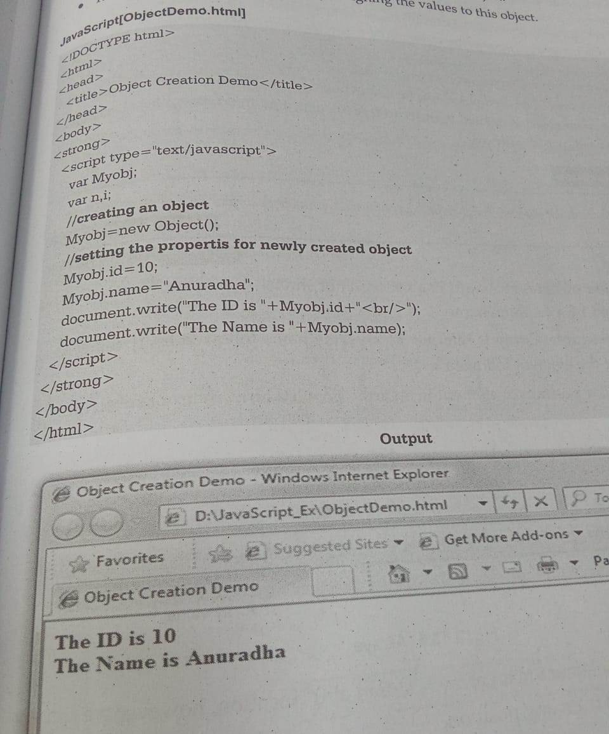

Slide 54
Arrays
Array is a collection of similar type of elements which can be referred any a common name.
The particular position of element in an array is called array index or subscript.
Declaring an Array –
In javascript the array can be created using Array object
Suppose, we want to create an array of 10 elements then we can write,
var ar = new Array(10);
Using new operator we can allocate the memory dynamically for the arrays.
In the brackets the size of array is mentioned and the var ar denotes the name of the array.
Thus arrary ar will be created in which we can store 10 elements at the most.

Slide 55
Defining an Array Elements
Var mylist = new Array(10,20,30,40,50)

Slide 56
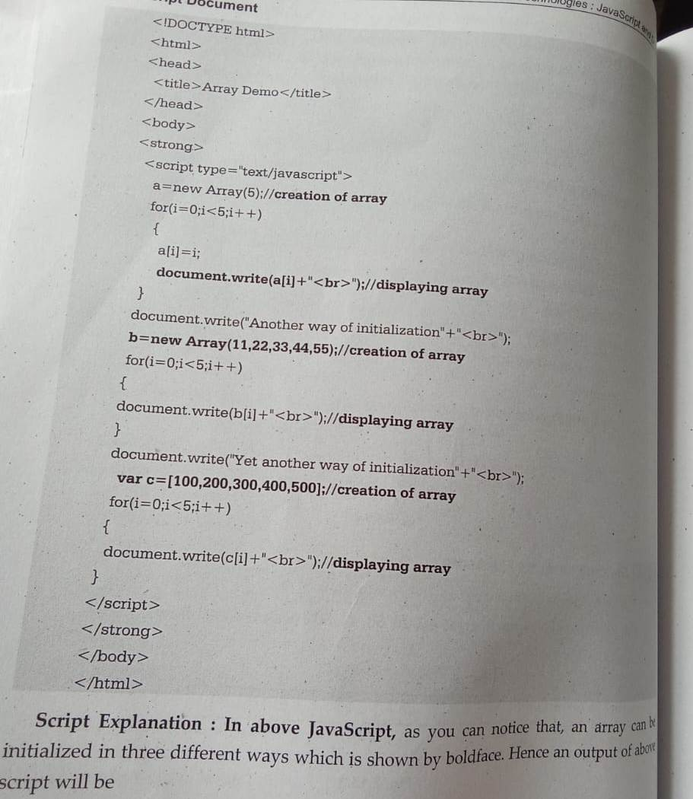

Slide 57
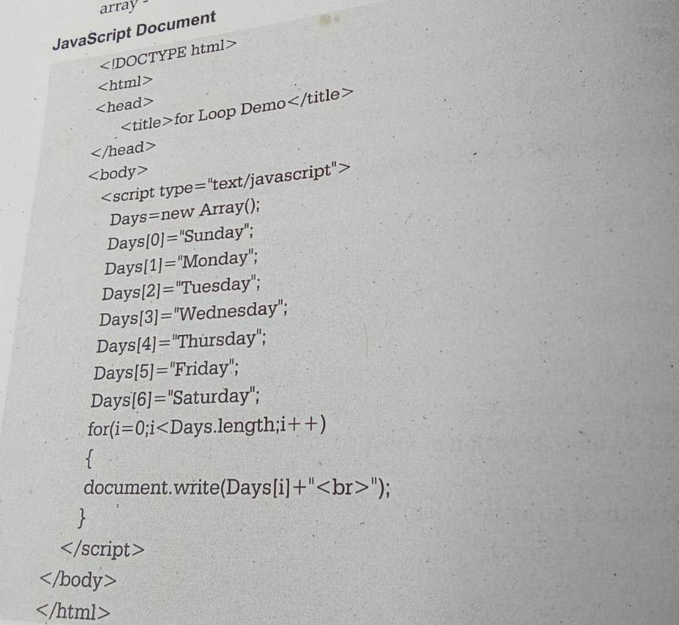
Looping an Array

Slide 58
Adding an Array element
We can add the element in the array at the end.
This increase the size of array.
Ex a=new Array()
a[0] = 10;
A[1] = 20;
Document.write(“the elements in array are: ”);
For(i=0;i<a.length;i++)
{
document.write(a[i]+” ”); //10 20
}
a[a.length] = 30;
For(i=0;i<a.length;i++)
{
document.write(a[i]+” ”); // 10 20 30
}

Slide 59
Sorting an Array Element
The elements can be sorted using the built in function sort
Sorting is basically a process of arranging the elements in ascending order or increasing order.

Slide 60
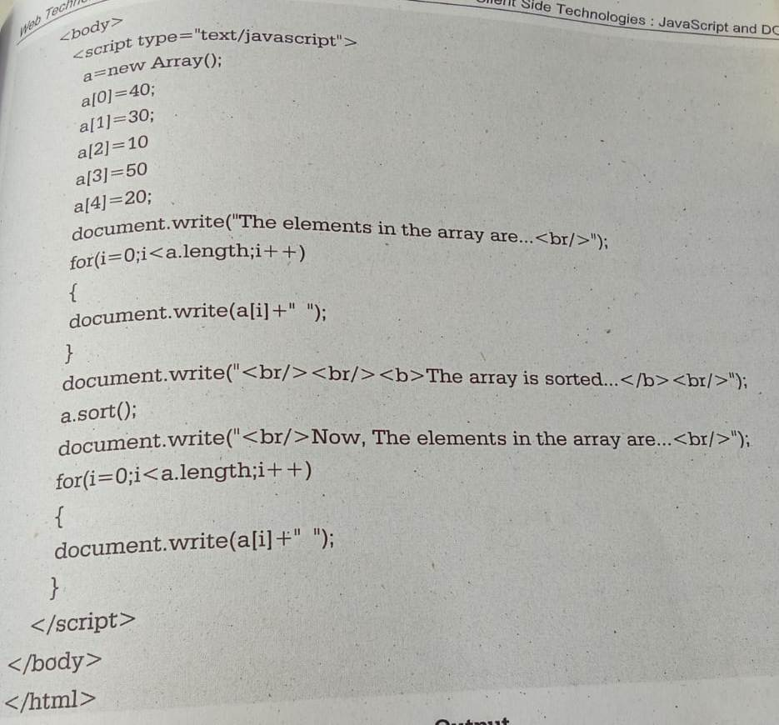

Slide 61
Combining Array Elements into String
In JavaScript it is possible to combine the array elements into string.
We need to use functions for combining array elements into string and those are – join() and concat()
There is difference between join() and concat() funtion. The concat() method separates each value with a comma. The join() method also uses a comma to separate values, but you can specify a character other than a comma to separate values

Slide 62
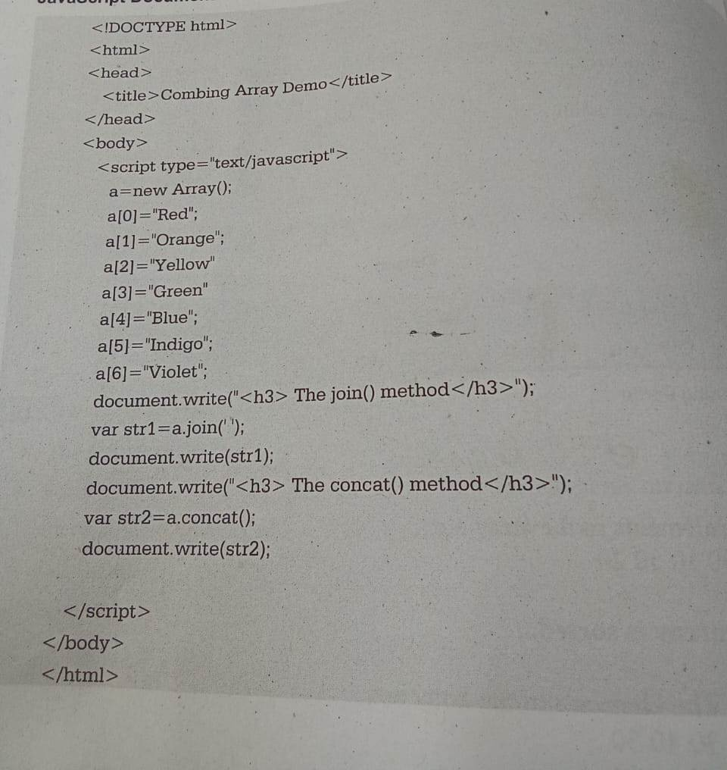

Slide 63
Output – The join() method
Red orange yellow green blue indigo violet
The concat() method
Red,orange,yellow,green,indigo,violet

Slide 64
Changing Elements of an Array
The shift() method removes the first item of an array.
The unshift() method adds new elements to the beginning of an array.
The unshift() method overwrites the original array.
The push() method adds new items to the end of an array.
The push() method changes the length of the array.
The push() method returns the new length.
The pop() method removes (pops) the last element of an array.
The pop() method changes the original array.
The pop() method returns the removed element.
Try - https://www.w3schools.com/jsref/jsref_shift.asp

Slide 65
JavaScript Array reverse()
The reverse() method reverses the order of the elements in an array.
The reverse() method overwrites the original array.
<script>
// Create an Array
const fruits = ["Banana", "Orange", "Apple", "Mango"];
// Reverse the Array
const fruits2 = fruits.reverse();
document.getElementById("demo").innerHTML = fruits2;
</script>

Slide 66
Manipulating a string
Joining a string – we can join two strings using + operator .
Ex. – var firstname = “AAA”
var lastname = “BBB”
var name = firstname + lastname
output – AAA BBB

Slide 67
Receiving a character from given position
The charAt() method returns the character at a specified index (position) in a string.
The index of the first character is 0, the second 1, ...
Try - https://www.w3schools.com/jsref/jsref_charat.asp

Slide 68
Dividing text
The split() method splits a string into an array of substrings.
The split() method returns the new array.
The split() method does not change the original string.
The split() method creates a new array and then copies portions of the string called substring, into its array element
If (" ") is used as separator, the string is split between words

Slide 69
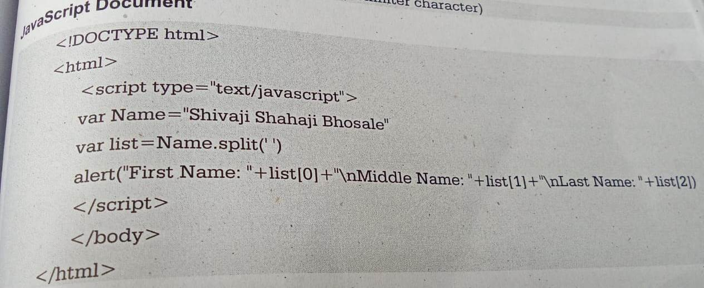

Slide 70
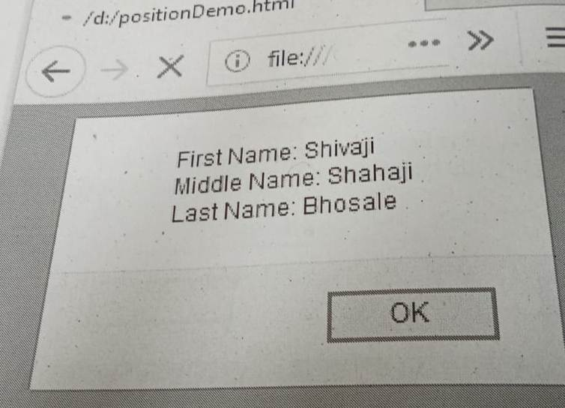

Slide 71
Copying a substring
The syntax of substring is :
substring (start, end)
where start indicates the starting index and end indicates the ending index for extracting substring.
substr() and substring() are string methods used to extract parts of a string. The main difference is that substr() accepts a length parameter, while substring() accepts start and end indices.
sunstr (start, length)

Slide 72
Converting string to number and number to string
paeseInt() - it is used to convert a string into an integer.
parseFloat() – it is used to convert string into float
let a = "100";
console.log("Type of a before conversion: " + typeof a); //o/p - string
console.log("Type of a after conversion: " + typeof parseInt(a)); // o/p number

Slide 73
Changing case of string
Using toLowerCase() we can convert the capital letters in the string to small letter
Using toUpperCase() method we can convert the small letters to capital letters
EX – var str = “WELCOME FRIENDS”
var newstr = str.toLowerCase()
var str1= “welcome friends”
var newstr1 = str.toUpperCase()

Slide 74
Code Debugging
Programming code might contain syntax errors, or logical errors.
Many of these errors are difficult to diagnose.
Often, when programming code contains errors, nothing will happen. There are no error messages, and you will get no indications where to search for errors.
Searching for (and fixing) errors in programming code is called code debugging.

Slide 75
JavaScript Debuggers
With a debugger, you can also set breakpoints (places where code execution can be stopped), and examine variables while the code is executing.
Normally (otherwise follow the steps at the bottom of this page), you activate debugging in your browser with the F12 key, and select "Console" in the debugger menu.
If your browser supports debugging, you can use console.log() to display JavaScript values in the debugger window:

Slide 76
DOM (Document Object Model)
With the help of DOM we can add dynamic content to your web page.
Document Object Model is an API (Application Programming Interface)that represents and interacts with HTML or XML documents.
DOM (Document Object Model) is a hierarchical representation of HTML documents.
It defines the structure and properties of elements on a webpage, enabling JavaScript to dynamically access, manipulate, and update content, enhancing interactivity and functionality.

Slide 77
What is DOM?
DOM, or Document Object Model, is a programming interface that represents structured documents like HTML and XML as a tree of objects.
It defines how to access, manipulate, and modify document elements using scripting languages like JavaScript.
The DOM is a W3C (World Wide Web Consortium) standard and it defines a standard for accessing documents.
The W3C Dom standard is divided into three different parts:
Core DOM – standard model for all document types
XML DOM – standard model for XML documents
HTML DOM – standard model for HTML documents

Slide 78
Why is DOM Required?
HTML is used to structure the web pages and Javascript is used to add behavior to our web pages.
When an HTML file is loaded into the browser, the JavaScript can not understand the HTML document directly.
So it interprets and interacts with the Document Object Model (DOM), which is created by the browser based on the HTML document.
DOM is basically the representation of the same HTML document but in a tree-like structure composed of objects.
JavaScript can not understand the tags(<h1>H</h1>) in HTML document but can understand object h1 in DOM.

Slide 79
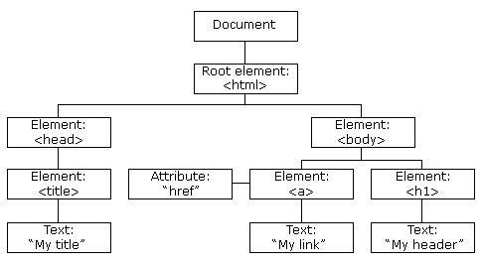
Dom structure for simple web document

Slide 80
Every element in the DOM tree is called node.
The topmost single node in the DOM tree is called the root
Every child node must have a parent node.
The bottom most nodes that have no children are called leaf nodes
The nodes that have the common parent are called siblings.

Slide 81
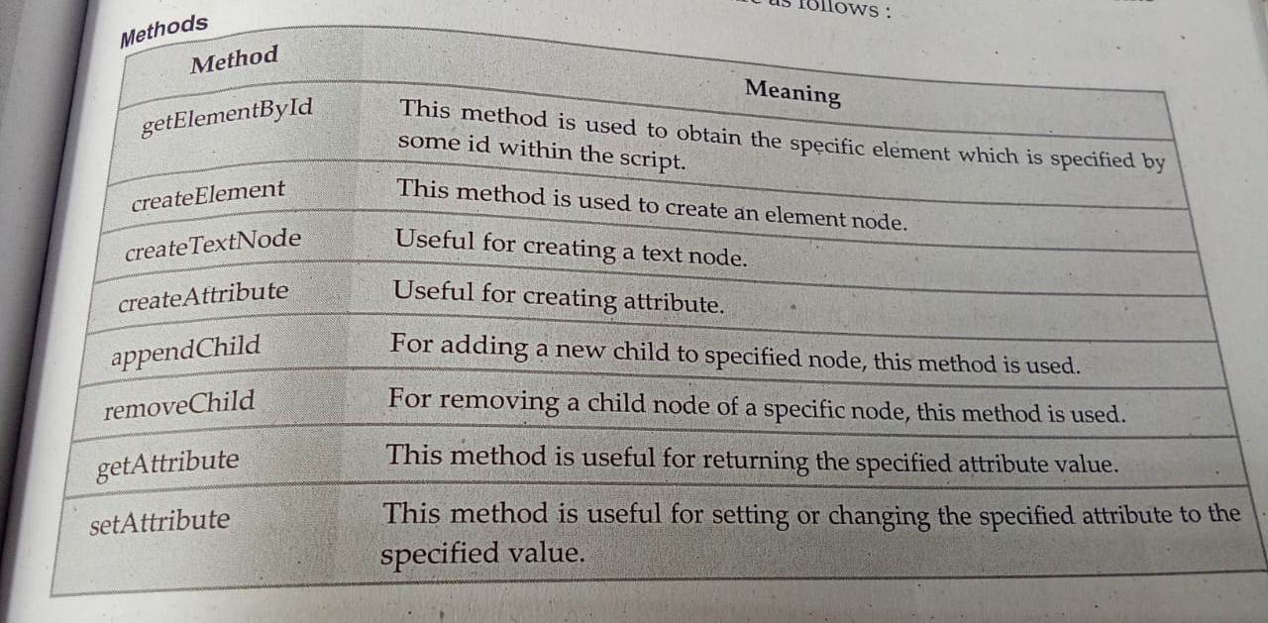
Modifying Element Style – we can access or change the contents of document by using various methods

Slide 82
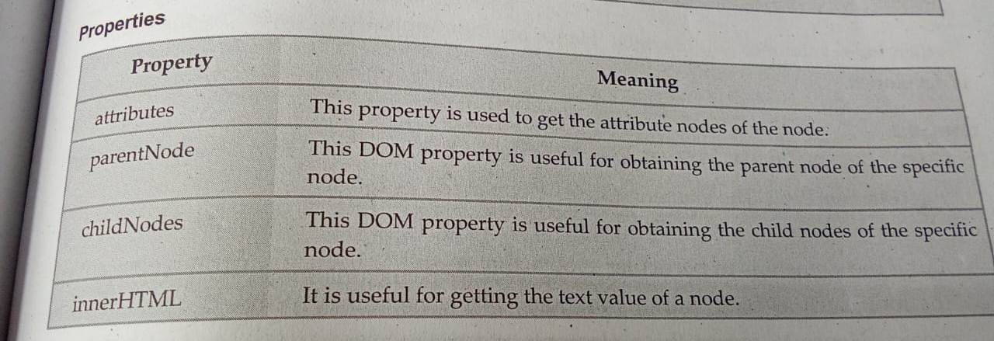

Slide 83
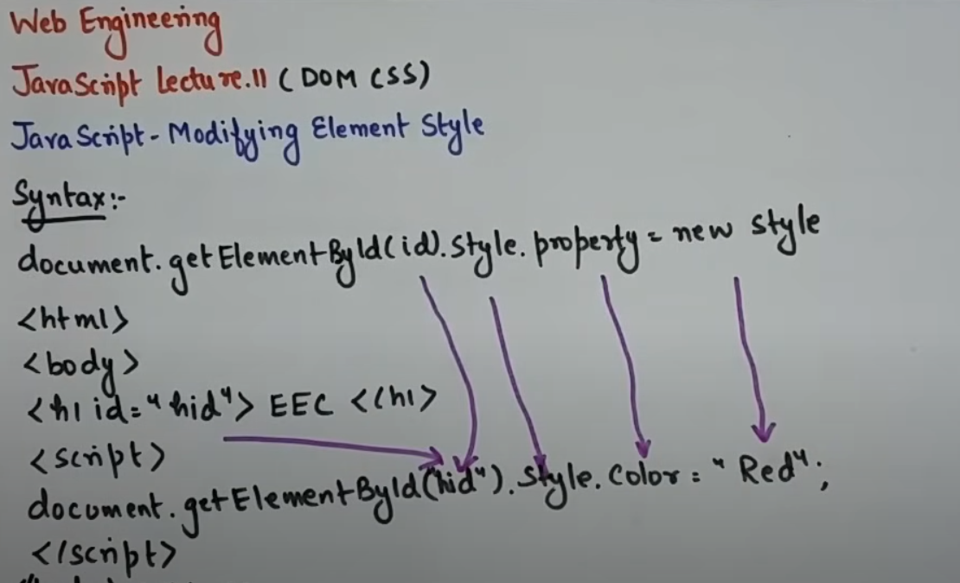
Accessing Element using DOM

Slide 84
Appending element using DOM
Append an item to a list:
const node = document.createElement(“p"); const textnode = document.createTextNode("Water"); node.appendChild(textnode); document.getElementById("myList").appendChild(node);
Try https://www.w3schools.com/jsref/tryit.asp?filename=tryjsref_node_appendchild

Slide 85
Inserting an element using DOM
<h2>JavaScript HTML DOM</h2>
<p>Add a new HTML Element.</p>
<div id="div1">
<p id="p1">This is a paragraph.</p>
<p id="p2">This is another paragraph.</p>
</div>
<script>
const para = document.createElement("p");
const node = document.createTextNode("This is new.");
para.appendChild(node);
const element = document.getElementById("div1");
const child = document.getElementById("p1");
element.insertBefore(para,child);
</script>
</body>
</html>

Slide 86
Removing an element using DOM
<h2>JavaScript HTML DOM</h2>
<h3>Remove an HTML Element.</h3>
<div>
<p id="p1">This is a paragraph.</p>
<p id="p2">This is another paragraph.</p>
</div>
<button onclick="myFunction()">Remove Element</button>
<script>
function myFunction() {
document.getElementById("p1").remove();
}
</script>
</body>
</html>

Slide 87
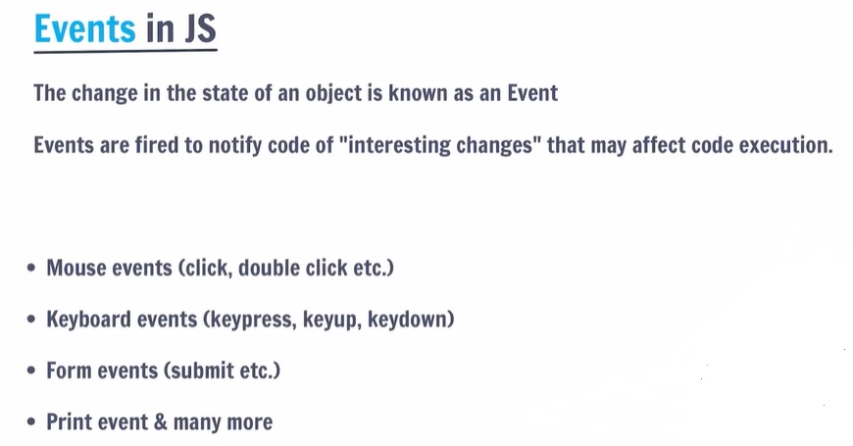
What is an Event

Slide 88
DOM event handling
Event is an activity that represents a change in the environment. For example mouse clicks, pressing a particular key of keyboard represent the events. Such event are called intrinsic events.
Event handler is a script that gets executed in response to these events. Thus event handler enables the web document to respond the user activities through the browser window.
Events are specified in lowercase letters and these are case sensitive.

Slide 89
onblur Event
The onblur event occurs when an HTML element loses focus.
The onblur event is often used on input fields.
<input type="text" onblur="myFunction()">

Slide 90
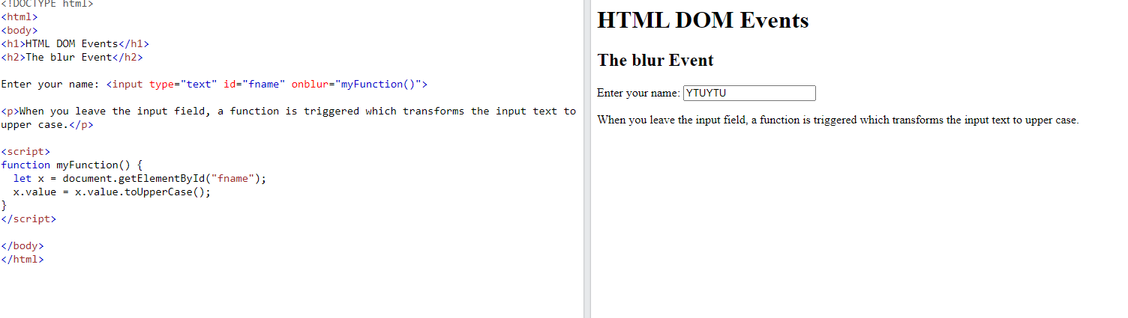

Slide 91
onfocus Event
The onfocus event occurs when an element gets focus.
The onfocus event is often used on input fields.
<input type="text" onfocus="myFunction()">

Slide 92
//this in a Function (Default) In a function, the global object is the default binding for this. In a browser window the global object is [object Window]
<!DOCTYPE html>
<html>
<body>
<h1>HTML DOM Events</h1>
<h2>The focus Event</h2>
Enter your name: <input type="text" onfocus="myFunction(this)">
<p>When the input field gets focus, a function changes the background-color.</p>
<script>
function myFunction(x) {
x.style.background = "yellow";
}
</script>
</body>
</html>

Slide 93
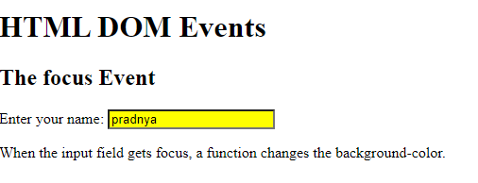

Slide 94
events
Events | Event Attribute
change | onchange
click | onclick
dbclick | ondblick
focus | onfocus
keyup | onkeyup
keydown | onkeydown
keypress | onkeypress
Change

Slide 95
Event | Event Attribute
mousedown | onmousedown
mousekey | onmouseup
mousemove | onmousemove
mouseout | onmouseout
mouseover | onmouseover
load | onload
submit | onsubmit

Slide 96
The use of tag attribute for handling the event is illustrated by following code example -
<input type = “button” name =“my_button”
Onclick = ‘my_fun()” ;
this means that when the user clicks the button then as an event handler a user defined function my_fun() gets called. In this function user writes the instruction that need to be executed on the button click event.

Slide 97
Properties of mouse events associated with DOM2
The onmousedown - It event occurs when a user presses a mouse button over an HTML element.
<p onmousedown="myFunction()">Click the text!</p>
Ex - https://www.w3schools.com/jsref/tryit.asp?filename=tryjsref_onmousedown

Slide 98
Difference between Event Handlers & addEventListener in JavaScript?
One difference is that if you add two event handlers for the same button click, the second event handler will overwrite the first and only that event will trigger. For example:
document.querySelector('.btn').onclick = function() {
console.log('Hello ');
};
document.querySelector('.btn').onclick = function() {
console.log('World!'); };
// This logs "World!" out to the console.

Slide 99
But if you use addEventListener instead, then both of the triggers will run.
document.querySelector('.btn').addEventListener('click', function() {
console.log('Hello ');
}); document.querySelector('.btn').addEventListener('click', function() {
console.log('World!');
}); // This logs "Hello" and "World!" out to the console.

Slide 100
Event Handlers: You can only attach one event handler per event type to an element. If you assign a new function to an event handler, it replaces the previous one.
addEventListener: You can attach multiple event listeners to the same event type on an element. They will all be executed in the order they were added.

Slide 101
Handling Events from body elements
The onload events gets activated as soon as the web page is loaded in the browser’s window
Eg - <body onload="myFunction()">
onload is most often used within the <body> element to execute a script once a web page has completely loaded all content (including images, script files, CSS files, etc.).
The onload event can be used to check the visitor's browser type and browser version, and load the proper version of the web page based on the information.

Slide 102
<!DOCTYPE html>
<html>
<body onload="myFunction()"> //when web documents gets loaded on the browser windowthen my_fun() wil be called
<h1>HTML DOM Events</h1>
<h2>The onload Event</h2>
<script>
function myFunction() {
alert("Page is loaded");
}
</script>
</body>
</html>

Slide 103
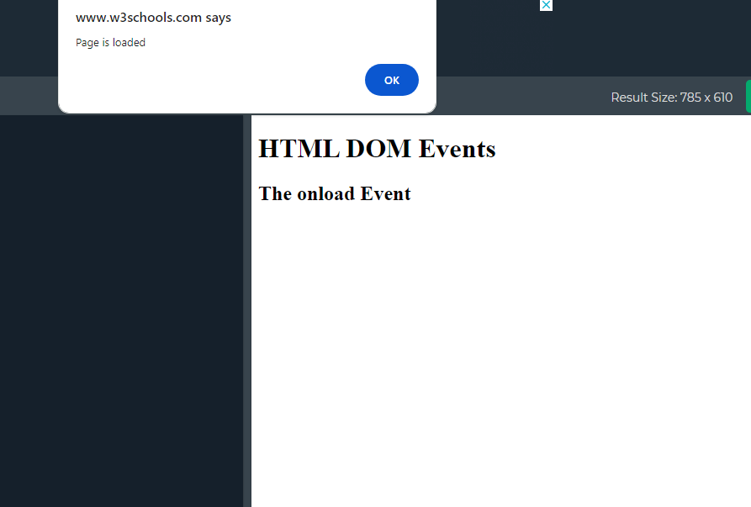
output

Slide 104
Form validation in JavaScript
<script type = “text/javascript”>
Function my_fun()
{
var mypwd = document.getElementById(“pwd”);
var my_re_pwd = document.getElementById(“re_pwd”);
If (myuname.value ==“”)
{
Alert(“you have not entered the password”);
Mypwd.focus();
Return false;
}
If(mypwd.value!= my_re_pwd.value)
{
Alert (“password is not verified,re-enter both the password”);
Mypwd.focus();
Return false;
}
Else
{
Alert(“congratulations!!”);
Return true;
}
}

Slide 105
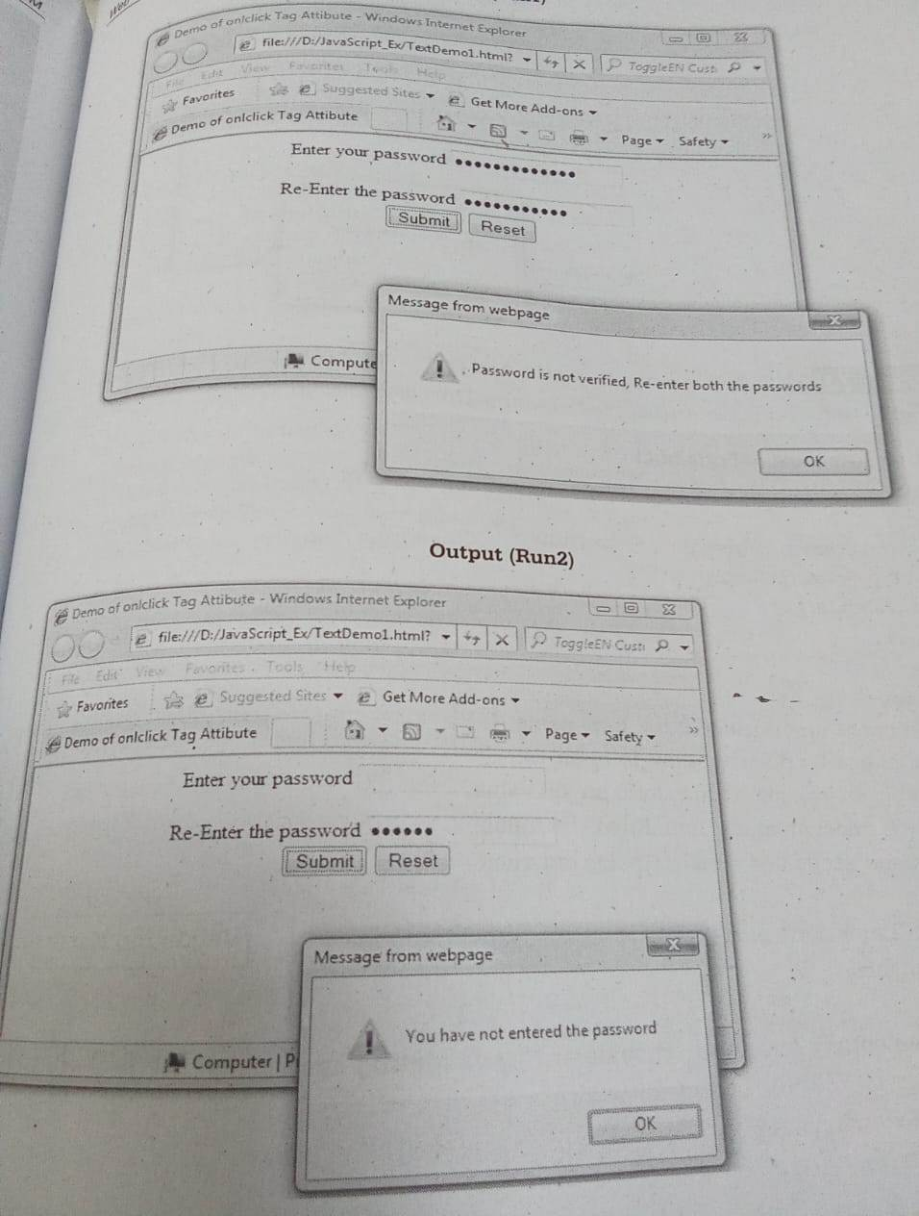

Slide 106
Jquery
jQuery is a lightweight, "write less, do more", JavaScript library.
The purpose of jQuery is to make it much easier to use JavaScript on your website.
jQuery takes a lot of common tasks that require many lines of JavaScript code to accomplish, and wraps them into methods that you can call with a single line of code.
jQuery also simplifies a lot of the complicated things from JavaScript, like AJAX calls and DOM manipulation.

Slide 107
Advantages of jQuery
Simplicity: jQuery simplifies JavaScript coding by providing easy-to-use methods and utilities.
Cross-browser Compatibility: jQuery abstracts browser differences, making it easier to write code that works consistently across different browsers.
Large Ecosystem: jQuery has a large ecosystem of plugins and extensions that extend its functionality and provide additional features.
Performance: jQuery is optimized for performance, with efficient DOM manipulation and event handling.

Slide 108
Limitations of jQuery
Size: It adds to the page load time due to its file size, especially for simple tasks where vanilla JavaScript could suffice.
Dependency: It is an external dependency, which means relying on a third-party library for functionality.
Overhead: It may introduce unnecessary overhead for projects that don’t require its extensive features.
Learning Curve: While jQuery simplifies many tasks, it still has a learning curve, especially for beginners transitioning to JavaScript development.

Slide 109
Application of jQuery
DOM Manipulation: It simplifies the process of traversing and manipulating the HTML DOM.
Event Handling: It provides easy-to-use methods for attaching event handlers to HTML elements.
AJAX Requests: It makes it easy to perform AJAX requests and handle server responses asynchronously.
Animations: It offers a wide range of animation effects that can be applied to HTML elements.
Form Validation: It provides plugins and utilities for validating form input and handling form submission.

Slide 110
The jQuery library contains the following features:
HTML/DOM manipulation
CSS manipulation
HTML event methods
Effects and animations
AJAX (Asynchronous JavaScript and XML (Ajax) refer to a group of technologies that are used to develop web applications)
Utilities

Slide 111
The jQuery library contains the following features:
HTML/DOM manipulation
CSS manipulation
HTML event methods
Effects and animations
AJAX
Utilities

Slide 112
Adding JQuery to Your Web Pages
There are several ways to start using jQuery on your web site. You can:
Download the jQuery library from jQuery.com
Include jQuery from a CDN, like Google
Downloading jQuery -
There are two versions of jQuery available for downloading:
1) Production version - this is for your live website because it has been minified and compressed
2) Development version - this is for testing and development (uncompressed and readable code)

Slide 113
JQuery Syntax
Basic syntax is: $(selector).action()
A $ sign to define/access jQuery
A (selector) to "query (or find)" HTML elements
A jQuery action() to be performed on the element(s)
Examples:
$(this).hide() - hides the current element.
$("p").hide() - hides all <p> elements.
$(".test").hide() - hides all elements with class="test".
$("#test").hide() - hides the element with id="test"

Slide 114
Libraries
To load a hosted library, copy and paste the HTML snippet for that library (shown below) in your web page. For instance, to load jQuery, embed the
<script src="https://ajax.googleapis.com/ajax/libs/jquery/3.7.1/
jquery.min.js"></script> snippet in your web page.
What is AJAX used for?
Ajax enables a web application user to interact with a web page without the interruption of constant web page reloading. Website interaction happens quickly with only portions of the page reloading and refreshing. Ajax is made up of the following technologies: XHTML and CSS for presenting information.

Slide 115
jQuery ready() Method
Use ready() to make a function available after the document is loaded:
Syntax - $(document).ready(function) - The ready() method can only be used on the current document, so no selector is required
The ready event occurs when the DOM (document object model) has been loaded.
Because this event occurs after the document is ready, it is a good place to have all other jQuery events and functions

Slide 116
jQuery slideToggle() Method
The slideToggle() method toggles between slideUp() and slideDown() for the selected elements.
This method checks the selected elements for visibility. slideDown() is run if an element is hidden. slideUp() is run if an element is visible - This creates a toggle effect.
https://www.w3schools.com/jquery/eff_slidetoggle.asp

Slide 117
jQuery Selectors
jQuery selectors allow you to select and manipulate HTML element(s).
jQuery selectors are used to "find" (or select) HTML elements based on their name, id, classes, types, attributes, values of attributes and much more. It's based on the existing CSS Selectors

Slide 118
The element Selector
The jQuery element selector selects elements based on the element name.
You can select all <p> elements on a page like this:
$(document).ready(function(){
$("button").click(function(){
$("p").hide();
});
});

Slide 119
example
https://www.w3schools.com/jquery/tryit.asp?filename=tryjquery_hide_p

Slide 120
The #id Selector
The jQuery #id selector uses the id attribute of an HTML tag to find the specific element.
An id should be unique within a page, so you should use the #id selector when you want to find a single, unique element.
To find an element with a specific id, write a hash character, followed by the id of the HTML element:
$(document).ready(function(){
$("button").click(function(){
$("#test").hide();
});
});

Slide 121
Example
https://www.w3schools.com/jquery/tryit.asp?filename=tryjquery_hide_id

Slide 122
The .class Selector
The jQuery .class selector finds elements with a specific class.
To find elements with a specific class, write a period character, followed by the name of the class:
$(document).ready(function(){
$("button").click(function(){
$(".test").hide();
});
});

Slide 123
example
https://www.w3schools.com/jquery/tryit.asp?filename=tryjquery_hide_class

Slide 124
The href Selector
The href element is used along with the anchor tag in order to introduce hyperlink in the web document
We can navigator to the desired web page using such hyperlinks
https://www.w3schools.com/jquery/tryit.asp?filename=tryjquery_sel_hrefattr

Slide 125
The tr selector
The element tr is used to define the rows of the table.
$("tr:even") Selects all even <tr> elements
$("tr:odd") Selects all odd <tr> elements
https://www.w3schools.com/jquery/tryit.asp?filename=tryjquery_sel_even

Slide 126
Changing Style - jQuery - css() Method
The css() method sets or returns one or more style properties for the selected elements.
The following example will return the background-color value of the FIRST matched element:
$("p").css("background-color");
https://www.w3schools.com/jquery/jquery_css.asp

Slide 127
jQuery - Add Elements
We will look at four jQuery methods that are used to add new content:
append() - Inserts content at the end of the selected elements
prepend() - Inserts content at the beginning of the selected elements
after() - Inserts content after the selected elements
before() - Inserts content before the selected elements

Slide 128
Angular JS
Angular JS is a powerful javascript framework
It is an open source front-end enabled web application framework.
It is licensed under Apache license version 2.0
It extends HTML DOM with additional attributes.it is more responsiv to user actions

Slide 129
Advantage
Code reusability – it support for using the reusable components.
Less code – It supports for less code and more functionality.
Unit Testing – the AngularJS code is unit testable.
Rich Features – There is wide range of features supported by Angular JS such as Data binding, dependency injection, enterprise level testing so on.
Built by Google Engineers – The Angular JS is maintained by dedicated Google Engineers.
MVC support – it is based on Model View Controller(MVC) architecture which provides separation of model ,view and controller components.

Slide 130
Disadvantages
As Angular JS is based on JavaScript framework, it is not secure.
There are multiple ways to do the same thing with AngularJS . Sometimes it can be hard to say which way is better for task

Slide 131
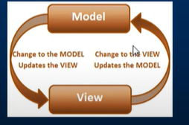
Features of Angular JS
Data Binding – It allows the automatic synchronization between model and view components
Scope – There are some objects from model that can be correlated to controller and view

Slide 132
3. Controller - These are basically Javascript functions that are bound to particular scope
4. Directives – the directives is designed to give HTML new functionality.
5. Filters – This feature allows to select subset from array of elements.
6. Routing – this features allows to switch between multiple views.
7. Services – There is support for many built in services for Angular JS.
8. Dependency Injection – It is a Software design pattern that helps the developer to develop and understand the application easily.

Slide 133
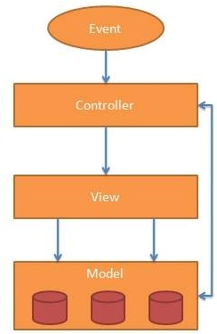
MVC with AngularJS

Slide 134
MVC with AngularJS
The MVC stands for Model , View and Controller. It is a pattern for the architectural framework. It consist of three parts -
Model – This part of the architecture is responsible for managing the application data. This module responds to the request made from view . This module responds to the request made from view. the model gives instructions to controller to update when the response is made

Slide 135
View: It is responsible for displaying all data or only a portion of data to the users. It also specifies the data in a particular format triggered by the controller's decision to present the data. They are script-based template systems such as JSP, ASP, PHP and very easy to integrate with AJAX technology.
Controller: It is responsible to control the relation between models and views. It responds to user input and performs interactions on the data model objects. The controller receives input, validates it, and then performs business operations that modify the state of the data model.

Slide 136
AngularJS Directives
AngularJS lets you extend HTML with new attributes called Directives.
AngularJS has a set of built-in directives which offers functionality to your applications.
AngularJS also lets you define your own directives.

Slide 137
AngularJS Directives
AngularJS directives are extended HTML attributes with the prefix ng-.
The ng-app directive initializes an AngularJS application.
The ng-init directive initializes application data.
The ng-model directive binds the value of HTML controls (input, select, textarea) to application data.
https://www.tutorialspoint.com/angularjs/angularjs_directives.htm

